Slide 1

Spring Boot

Slide 2
Agenda
What is Web Application Architecture?
What is Spring Boot?
Why We should use Spring Boot framework?
What is a Spring Bean?
Basic annotations
Three-Layer Architecture
Create our first Spring Boot Application

Slide 3
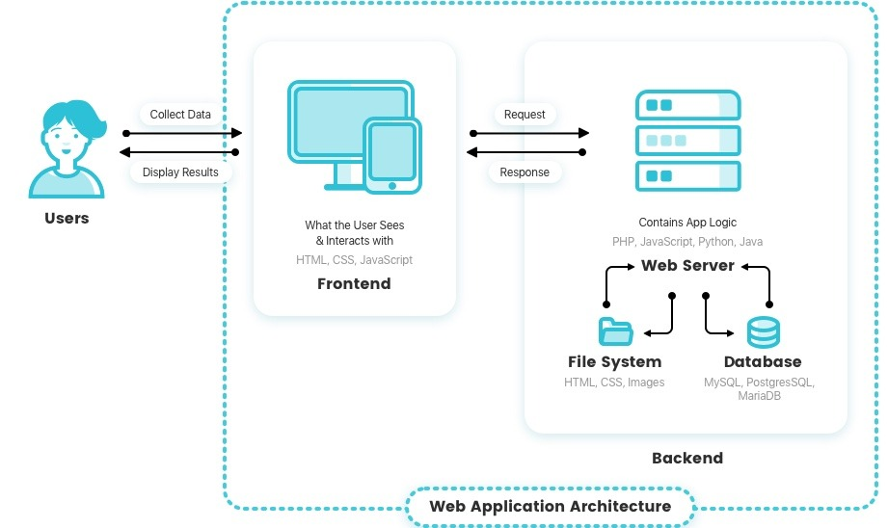
What is Web Application Architecture

Slide 4
What is Spring Boot?
Spring Boot is an open-source framework built on top of Spring Framework
It simplifies the development of standalone, production-ready Spring applications
Eliminates boilerplate configuration
Provides embedded servers (Tomcat, Jetty)

Slide 5
We should use Spring Boot framework because:
The most popular Java framework for Back-end/API development.
The dependency injection approach is used in Spring Boot.
It provides powerful transaction management capabilities for persistent data handling.
It simplifies integration with other Java frameworks like JPA/Hibernate ORM.
It reduces the cost and development time of the application.

Slide 6
What is a Spring Bean?
Here's a definition of beans in the Spring Framework documentation:
In Spring, the objects that form the backbone of your application and that are
managed by the Spring IoC container are called beans. A bean is an object that is
instantiated, assembled, and otherwise managed by a Spring IoC container.

Slide 7
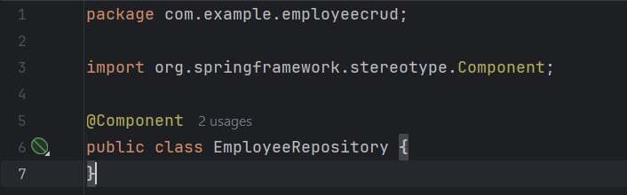
@Component annotation
This is a generic annotation and can be applied to any class of the application to make it a
spring managed component. When the classpath is scanned by the spring’s component-scan (@ComponentScan) feature, it will identify the classes annotated with @Component annotation (within the given package) and create the beans of such classes and register them in the ApplicationContext.

Slide 8
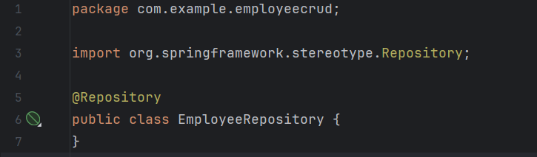
@Repository annotation
A specialization of the @Component annotation. This annotation designated the bean class as
a spring managed component in the persistence layer/Repository layer. It notify the spring that
the class will contain the logic for accessing the data. @Repository translates any unchecked
exceptions (application specific exceptions, database-specific SQL exceptions etc…) thrown
from Repository methods into Spring’s DataAccessException. (once the exception is
occurred, it will communicate with PersistenceExceptionTranslationPostProcessor to translate
the exception into Spring’s DataAccessException)

Slide 9
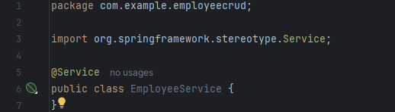
@Service annotation
A specialization of the @Component annotation. It indicates that a class is a “Business
Service Facade” or something similar. It doesn’t currently provide any additional behavior over
the @Component annotation.

Slide 10
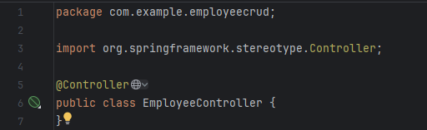
@Controller annotation
Spring @Controller annotation can be applied on classes only. It’s used to mark a class as a
web request handler. It’s mostly used with Spring MVC application.
We cannot switch this annotation with any other like @Service or @Repository, even though
they look same. The dispatcher scans the classes annotated with @Controller and detects
methods annotated with @RequestMapping annotations within them. We can use
@RequestMapping on/in only those methods whose classes are annotated with @Controller
and it will NOT work with @Component, @Service, @Repository

Slide 11
Introduction to Three-Layer Architecture
The Layered Architecture deals with an application as a monolith, separating it’s logic into
different layers. Each of those layers is dependent on the one below it. Despite it being so,
the use of Layered Architecture is that each of layers can be changed without having to
change the other ones.
Key Benefits:
Separates responsibilities into three layers for better maintainability, scalability, and testability.
Improves code reusability and modularity.
Makes debugging and testing easier.

Slide 12
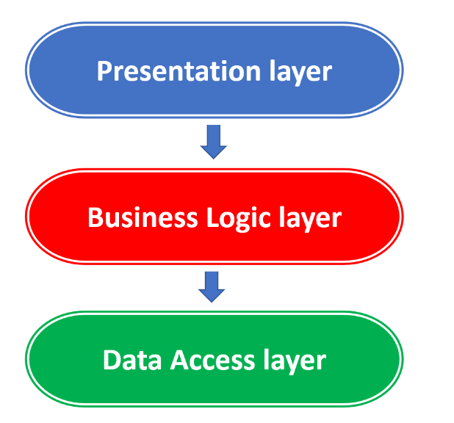
Layers in Spring Boot:
Controller Layer (Presentation Layer) – Handles HTTP requests & responses.
Service Layer (Business Logic Layer) – Implements business logic & validation.
Repository Layer (Data Access Layer) – Manages persistence operations.

Slide 13
Controller Layer (Presentation Layer)
Purpose:
Acts as an entry point for handling HTTP requests from clients (Frontend or API consumers).
Controllers receive requests, process them, and interact with the service layer to retrieve or manipulate data.
Key Annotations:
@RestController – Marks the class as a REST API controller.
@RequestMapping("/endpoint") – Defines the base URL for the controller.
@GetMapping, @PostMapping, @PutMapping, @DeleteMapping – Maps HTTP methods to specific actions.
@PathVariable, @RequestParam, @RequestBody – Extracts input data from requests.

Slide 14
Service Layer (Business Logic Layer)
Purpose:
Contains business logic, rules, and calculations.
Acts as a bridge between the Controller and Repository layers.
Reduces complexity in controllers by abstracting logic into separate classes.
Can call external APIs, services, or other components.
Key Annotations:
@Service – Marks a class as a service component.
@Autowired (or constructor-based injection) – Injects dependencies.

Slide 15
Repository Layer (Data Access Layer)
Purpose:
Manages communication with any data source.
Uses Spring Data JPA to simplify persistence operations.
Provides CRUD (Create, Read, Update, Delete) operations without needing manual SQL queries.
Key Annotations:
@Repository – Marks a class as a repository component.
JpaRepository<T, ID> – Provides predefined database methods.
@Query – Allows writing custom SQL queries when needed.

Slide 16
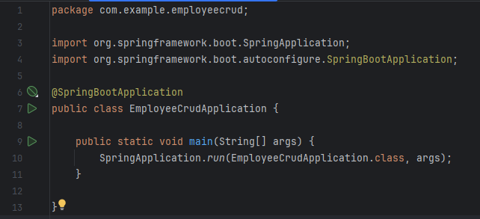
The entry point in Boot Application
The java class annotated with @SpringBootApplication is the main class of a Spring Boot application and application starts from here.
The shortcut @SpringBootApplication annotation is equivalent to using @Configuration, @EnableAutoConfiguration, and @ComponentScan and will pick up all config classes in or bellow the package where the class is defined.

Slide 17
Useful Links & References
Web Application Architecture
Three-Layered Architecture (With Example)
What is Spring Bean

